Slide 1

Farmers' Market Setup and Launch
Project by:
Ali Abedini
Elham Keshavarzsafiei
Aynaz Sardast
Shakiba Salmanpour
Md Fahim Hossain

Slide 2

Project Overview
This project aims to establish a Farmers Market where local farmers and artisans can sell fresh produce and handmade goods directly to the community. It promotes local agriculture, strengthens community ties, and supports sustainable practices.
Total Budget: €24,500
Time frame : From 11.10.24 To 10.01.25

Slide 3
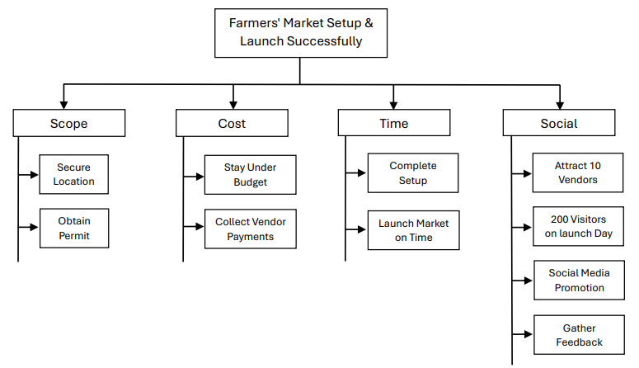
Goals of the Project
Figure: Goals of the Project

Slide 4
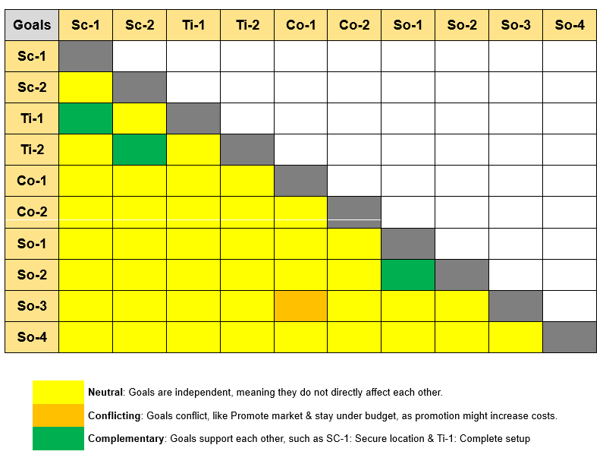
Goals Relationship Matrix
Figure: Goals Relationship Matrix

Slide 5
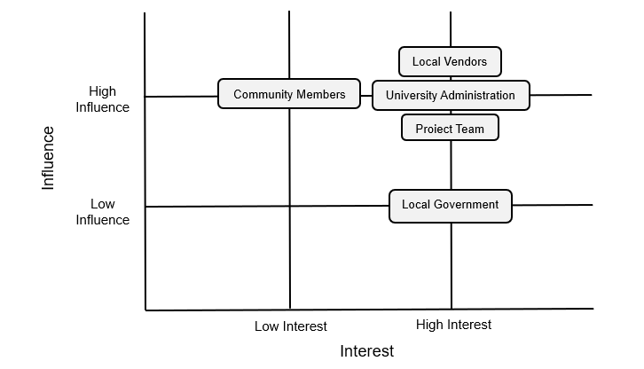
Project Stakeholders
SL | Stake Holders | Power
1 | Local Vendors | High
2 | Community Members | Low
3 | University Administration | High
4 | Local Government | High
5 | Project Team | High

Slide 6
Risk Evaluation Before Risk Management
No | Description of Risk | Probability in % | Threat in Euro | Risk Value in Euro
1 | Permit delays | 30% | 2,000 | 600
2 | Budget overrun | 40% | 3,000 | 1,200
3 | Adverse weather | 20% | 1,500 | 300
4 | Low vendor participation | 25% | 2,000 | 500
5 | Inefficient tools for registration | 15% | 1,000 | 150

Slide 7
Risk Management Plan
Risk Management Plan
Risk | Strategy | Costs in € | Action
Permit delays | Preventive | 1,000 | Applicable
Permit delays | Corrective | 200 | Applicable
Budget overrun | Preventive | 700 | Applicable
Budget overrun | Corrective | 300 | Applicable
Adverse weather | Preventive | 1,000 | Ignore
Adverse weather | Corrective | 500 | Ignore
Low vendor participation | Preventive | 700 | Applicable
Low vendor participation | Corrective | 200 | Applicable
Inefficient tools for registration | Preventive | 300 | Ignore
Inefficient tools for registration | Corrective | 100 | Ignore

Slide 8
Risk Evaluation After Risk Management
Total Risk value before Risk management : €2,750
Total Risk value after Risk management : €1,300
Total cost of Risk management Plan : €3,100
Risk Surcharge: €4,400
Risk Evaluation after Risk Management Plan
No | Final Risk | Probability | Threat in € | Risk Value 2 in €
1 | Permit delays | 10% | 2,000 | 200
2 | Budget overrun | 20% | 3,000 | 600
3 | Adverse weather | 10% | 1,500 | 150
4 | Low vendor participation | 15% | 2,000 | 300
5 | Inefficient tools for registration | 5% | 1,000 | 50

Slide 9
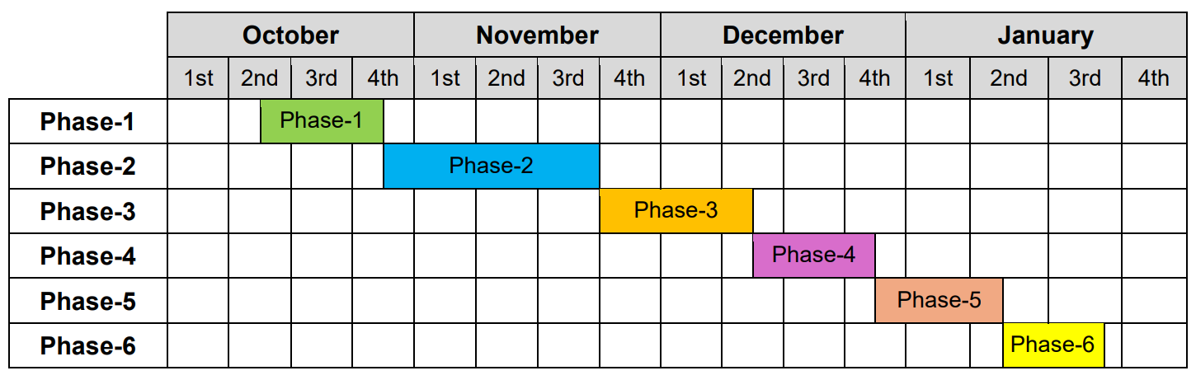
Graphical Representation Of Project Phases
Phase-1: Initiation
Phase-2: Planning
Phase-3: Vendor Recruitment
Phase-4: Marketing Campaign Launched
Phase-5: Setup and Logistics
Phase-6: Launch and Evaluation

Slide 10
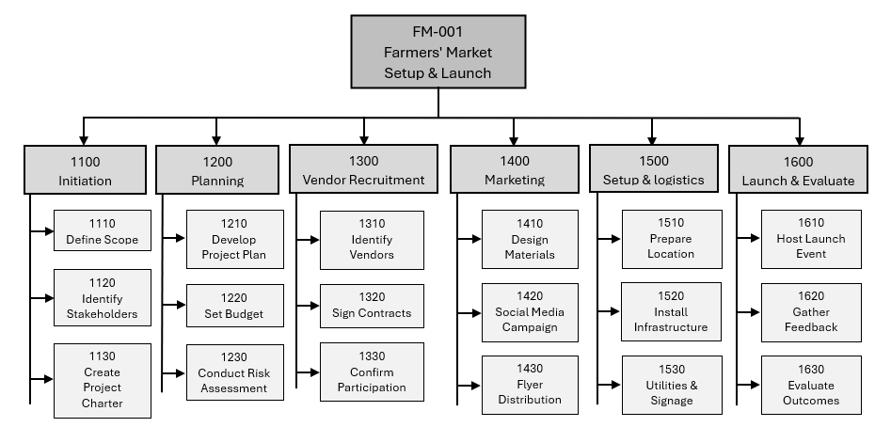
Project Structure Plan Graph

Slide 11
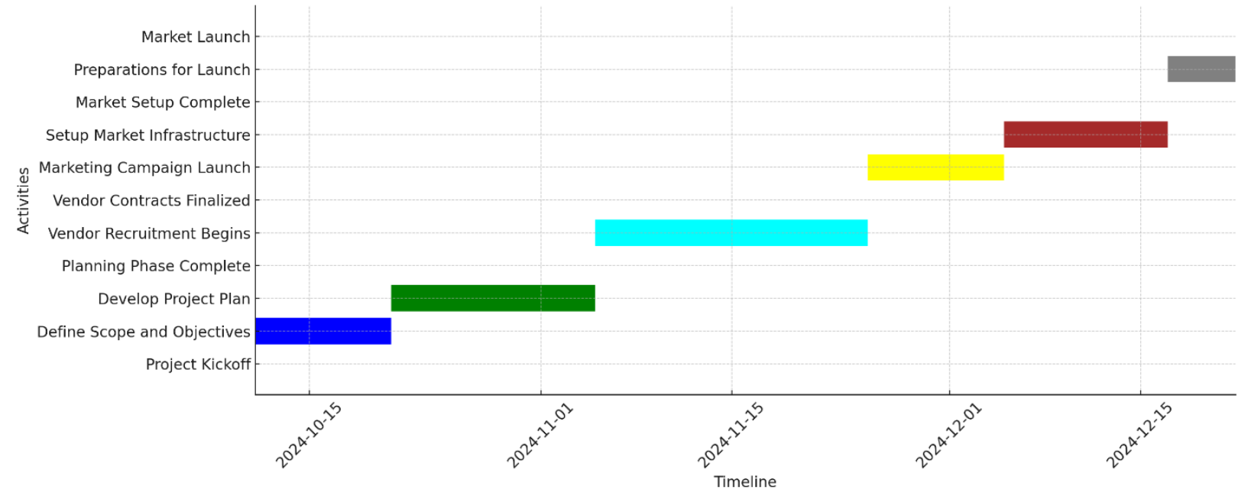
Gantt Chart
Schedule
Figure: Gantt Chart

Slide 12
Cost Planning
No | Type of Resource | Quantity (hours or pieces) | Costs per Unit | Total Costs
1 | Human Resource | 100 hours | €20 | €8,300
 |  | 75 hours
 |  | 75 hours
 |  | 90 hours
 |  | 75 hours
2 | Material | 300 flyers/30 posters | €1 | €650
 |  | 100 forms | €0.5
 |  | 1 | €300
 |  | 2 | €0
3 | Tools | Multiple | €300 | €300
4 | Parts from Suppliers | 20 | €350 | €10,500
 |  | 10 | €200
 |  | 5 | €300

Slide 13

Total Project Costing
The total project costs, including the resource costs and risk surcharge, are summarized below:
Resource Costs: €19,750
Risk Surcharge: €4,400
Total Project Budget: €24,150
Incorporating the risk surcharge and detailed cost breakdown ensures the project is financially equipped to handle unforeseen challenges and achieve a successful market launch.

Slide 14

Thank You

Slide 15

Health Track - Personal Health and Fitness Tracker -Agile Project
Project by:
Ali Abedini
Elham Keshavarzsafiei
Aynaz Sardast
Shakiba Salmanpour
Md Fahim Hossain

Slide 16
Key Functionalities
User Registration and Profile Management
Health and Daily Activity Monitoring
Goal Setting and Progress Analysis
Wearable Device Integration
Alerts and Notifications
Visual Data Insights

Slide 17
Product Vision Board
Section | Description
Vision | Empower users to live healthier, more balanced lives by providing a personalized health tracking platform.
Target Group | Health-conscious individuals, fitness enthusiasts, and users with wearable devices seeking to improve their lifestyle.
Needs | - Track physical activities (steps, exercise). - Monitor hydration, nutrition, and sleep. - Set and achieve fitness goals. - View progress insights to stay motivated.
Product | A mobile app that allows users to log activities, integrate with wearable devices, receive reminders, and view progress reports.
Business Goals | - Attract 50,000 active users within the first year. - Partner with wearable device companies. - Generate revenue via premium subscriptions and ads.

Slide 18
User Stories
User Story-1: As a user, I want to register and set up a profile so that I can access personalized health tracking features.
User Story-2: As a user, I want to log my daily steps so that I can monitor my physical activity and progress.
User Story-3: As a user, I want to set hydration goals so that I can stay on top of my daily water intake
User Story-4: As a user, I want to view progress charts so that I can see trends in my health data.
User Story-5: As a user, I want to receive reminders for hydration and exercise so that I stay consistent with my goals.
User Story-6: As a user, I want to register and set up a profile so that I can access personalized health tracking features.
Continue…..

Slide 19
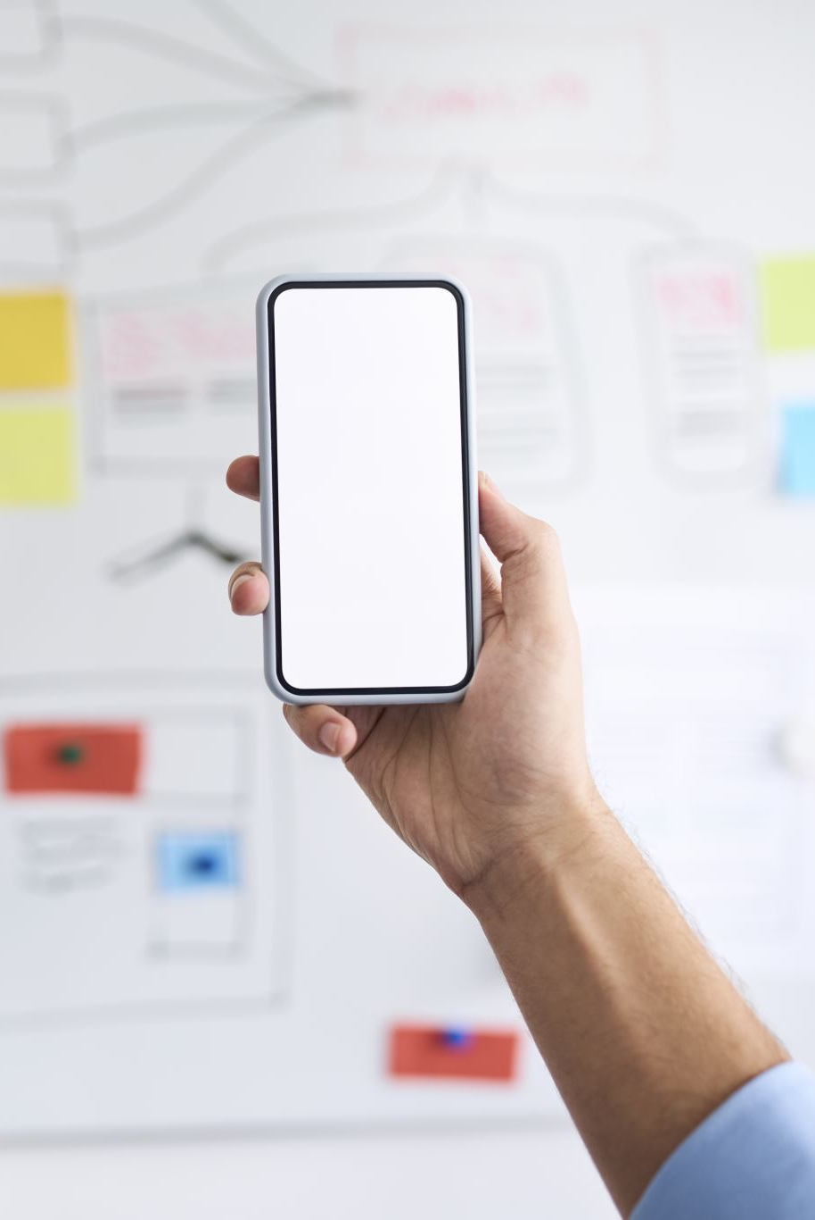
MVP Overview
Core Features of the MVP:
Registration and Profile Setup.
Track daily steps to monitor physical activity.
Set hydration goals to maintain daily water intake.
View progress charts to track health trends.
Get reminders for hydration and exercise.
Track calorie intake to monitor diet.
Sync smartwatch to automate activity tracking.
View weekly health summaries to track progress
Customize notifications for relevant reminders.

Slide 20

Thank You

